Slide 1
Final Presentation Chapman Enrollment Inefficiencies
Aria Haroonian, Carlo Castro, Eden Gal, Jess Sambrailo & Lex Nieto

Slide 2
DEFINING THE ORGANIZATION
The Organization
Revenues
Size
Competitors
Industry
Regulatory Issues
- Chapman University
- ASBE/ASBE Program Advising Center
- Peoplesoft
- KPMG annual audit = $458,499,000
- 8,000 undergrad students
- Private SoCal universities with similar tuition
- Public, regional Competitors
- Higher education system
- Peoplesoft access to academic outcomes
- Ensuring sanctity of data if changes to software are made under FERPA
Notes:
Regulatory Issues:
PeopleSoft has access to thousands of students' academic outcomes. In its current form, the sanctity of this data and personal privacy are not a concern. However, ensuring that this data remains private if changes are made to the current PeopleSoft software is a regulatory concern under regulations enforced by FERPAt.

Slide 3
THE INEFFICIENCY WE SEEK TO IMPROVE
Prerequisite Issues
GPA Requirements
Cost
PERC System
PeopleSoft doesn’t recognize different prerequisites based on their major/minor
150 hrs spent in first weeks of school helping students
Different catalog years have different GPA standards
2021-2022 → 2.7 GPA
Previous years → 2.5 GPA
Avg. salary for ASBE advisor $55,000 (Glassdoor, 2023)
40 hr work week = $26.44/hr
150 hours = $4,000
Post Enrollment Requisite Check
50-75 hours spent regulating process (Lopez, 2023)
Notes:
Needs to be described in a quantifiable manner: This means that you should be able to describe the impairment in terms of production inefficiencies in units, number of customers served in each period, amount of revenue lost or unrealized etc.

Slide 4
OUR PROPOSED SOLUTION
Filter 1: Categorical Year
Filter 2: Priority Queue
The Effect on PERC
-Distinguishing the year the student first enrolled at Chapman and cross checking it with the lower division GPA requirement for that same year
-First identifying the student’s major and then cross checking it with the prerequisite data for that specific major
-Prioritizing major prerequisites for a class, then minor prerequisites, then emphasis prerequisites
-Significant improvement and accuracy

Slide 5
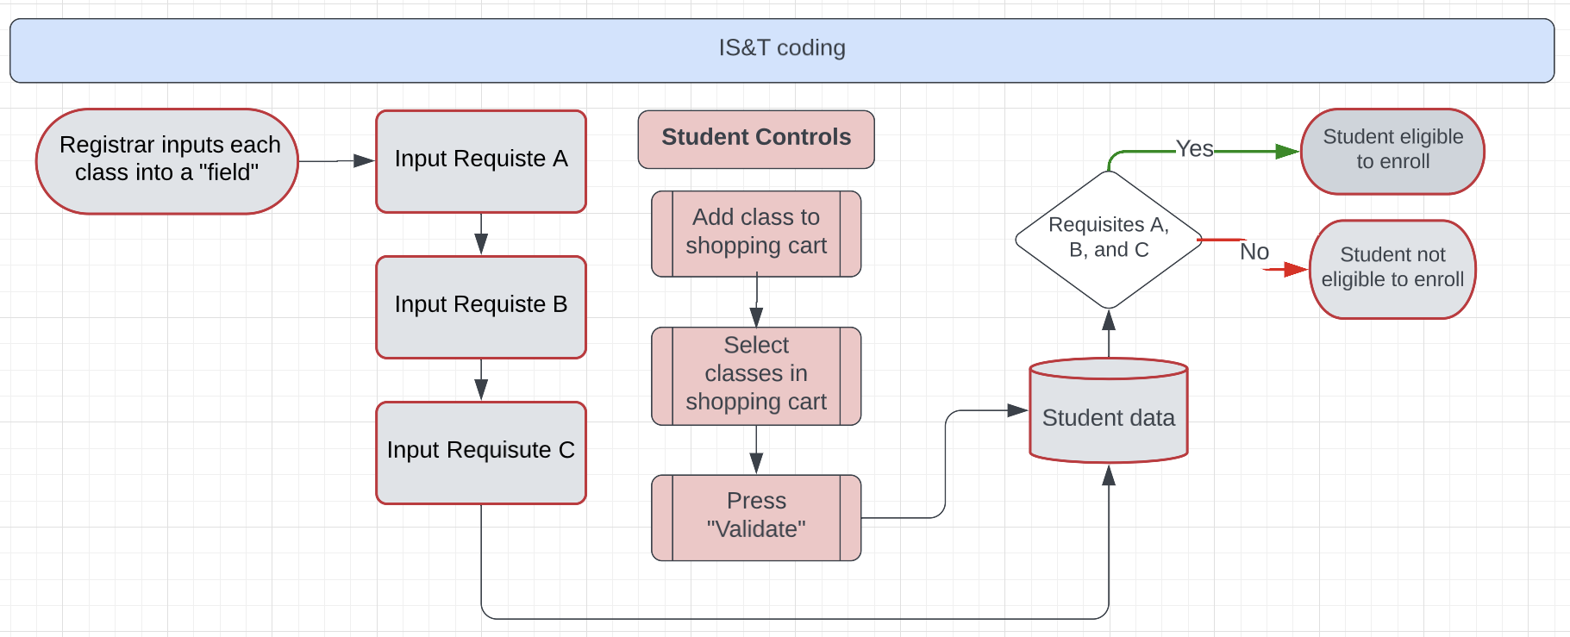
OUR PROPOSED SOLUTION
Existing Process

Slide 6
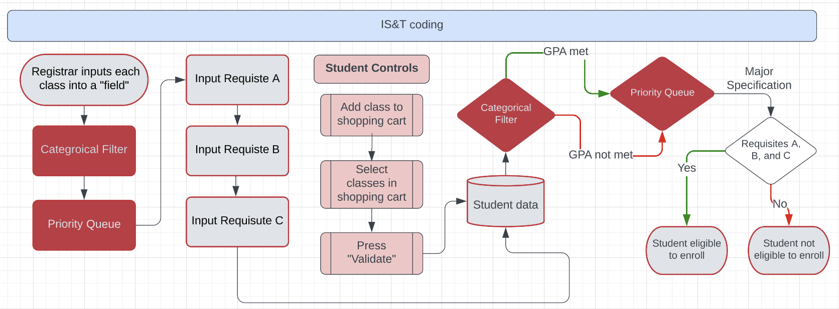
OUR PROPOSED SOLUTION
Revised Process

Slide 7
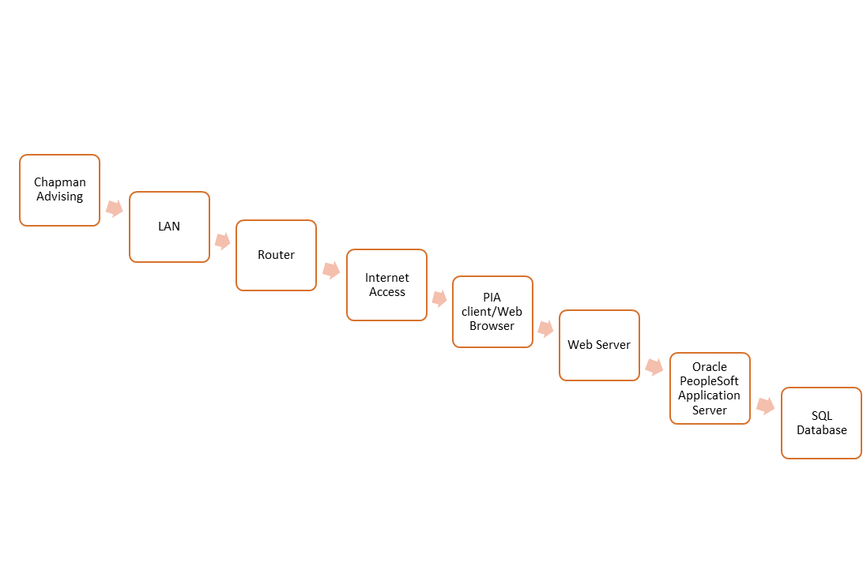
TECHNOLOGICAL COMPONENTS

Slide 8
IMPLEMENTATION SCHEDULE
1. Request Originated
4. Testing
7. Fill Fields
2. Meeting
5. Confirmation
8. Testing
3. Development
6. CAB
9. Release
Request for modification is submitted to IS&T
Project team and priority assigned
IS&T tests operability in a non-production environment
Registrar inputs data into new fields
Project team meets with requesting party and collects details
IS&T confirms new features meet requestors wants/needs
Registrar tests filter operability
Development begins
Length is determined by complexity of request
Change Advisory Board approves and ensures network stability
Change implemented
Mantooth, 2023
Notes:
Mention lauri citation

Slide 9
Task Timeline
 |  | Day
Task # | Implementation Timeline | 1 | 2 | 3 | 4 | 5 | 6 | 7 | 8 | 9 | 10 | 11 | 12 | 13 | 14 | 15 | 16 | 17 | 18 | 19 | 20
1 | Request Origination
2 | Meeting
3 | Development
4 | Testing
5 | Confirmation
6 | Change Advisory Board (CAB)
7 | Registrar inputs data
8 | Testing
9 | Implementation
Notes:
Testing accounts for over 50% of time used

Slide 10
CONTROLS
KPIs
CSFs
Measuring Permission Numbers
Filtering System
Reduction In Advising Hours
Prerequisites
Number of Students Pulled From their Classes
Policy and Procedures
Look at semester reports to see manually generated permission numbers
To implement the filtering system we want, the registrar needs to make the administrative changes
Advisors need to manually track the hours spent helping students with prerequisite registration issues
Prerequisites added need to be accurate
Courses in major/minor need to be accurate
Clearly state policies when prerequisites need to be added or changed per course
Look at reports from the registrar to measure the number of administrative drops

Slide 11
CONCLUSION
Implementation
IS&T: develops and tests new empty filters
Registrar: inputs data and ensures operability of filters
Quantifiable Benefits
Advisors have more time to work on 2 & 4 yr plans → increase ranking
Higher rank = justify charging premium tuition
Higher rank = decreased acceptance rate
Solution requires zero capital expenditure and minimal operational expenditure
Although this may not allow Chapman to directly increase tuition, Chapman should enact these solutions since CU benefits and derives value from these changes at minimal costs
Notes:
Rank - Also, taking the average cost of the five top private universities in America, we found that the average cost was around $85,000, similar to Chapman’s annual costs (Niche, 2023; MIT, 2023; Guillory, 2022; Princeton, 2023; Harvard, 2023; Yale, 2023). So, it is reasonable to conclude that universities like Chapman should strive for higher rankings to ensure they can continue charging premium tuition.

Slide 12
Who Benefits?
Students: More efficient enrollment/registration process
Advisors/Faculty: Less manual intervention, time can be dedicated elsewhere
Administration: Able to justify tuition via higher university ranking
Notes:
Rank - Also, taking the average cost of the five top private universities in America, we found that the average cost was around $85,000, similar to Chapman’s annual costs (Niche, 2023; MIT, 2023; Guillory, 2022; Princeton, 2023; Harvard, 2023; Yale, 2023). So, it is reasonable to conclude that universities like Chapman should strive for higher rankings to ensure they can continue charging premium tuition.

Slide 13
REFERENCES
California State University, Fullerton. (2022). Higher Education. Higher Education PeopleSoft
Customers - Common Management Systems (CMS) | CSUF. Retrieved March 15, 2023, from https://www.fullerton.edu/cms/project/customers.php
Chapman University. (2022). Facts & Rankings. Facts & Rankings | About Chapman | Chapman
University. Retrieved March 15, 2023, from https://www.chapman.edu/about/facts
-and-rankings/index.aspx
KPMG. (2022, May 31). Chapman University and Affiliates Consolidated Financial Statements.
KPMG.
Salary: Academic advisor in Los Angeles, CA 2023. Glassdoor. (2023). Retrieved March 16, 2023, from
https://www.glassdoor.com/Salaries/academic-advisor-salary-SRCH_IM508_KO0,16.htm?clickSource=searchBtn
YouTube. (2017). How PeopleSoft Works. YouTube. Retrieved May 2, 2023, from https://www.youtube.com/watch?v=e6F3AB4iNDo.

Slide 14
Questions?

